Slide 1
Assessment of gnss raw measurements by using different mobiles
By:
170050062 – K. Bindu Meghana
170050082 – N. Aswin Kumar
170050092 - P. Yatish Chandra
Guide : J R K Kumar Dabbakuti

Slide 2
PROBLEM STATEMENT
Many of the positioning and navigation systems cannot provide accurate results in remote areas, to overcome this we have used GNSS raw measurements for accurate positioning.

Slide 3
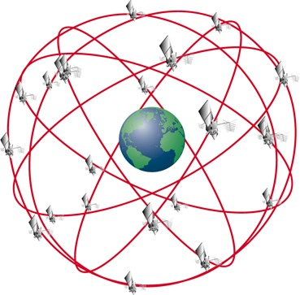
INTRODUCTION TO GNSS
Global Navigation Satellite System (GNSS) comprise several constellations such as
GPS (United States)
GLONASS (Russia)
GALILEO (Europe)
COMPASS (China)
IRNSS (India)
GNSS is designed to provide the instantaneous positioning, timing and navigation (PTN) information any where in the world .

Slide 4
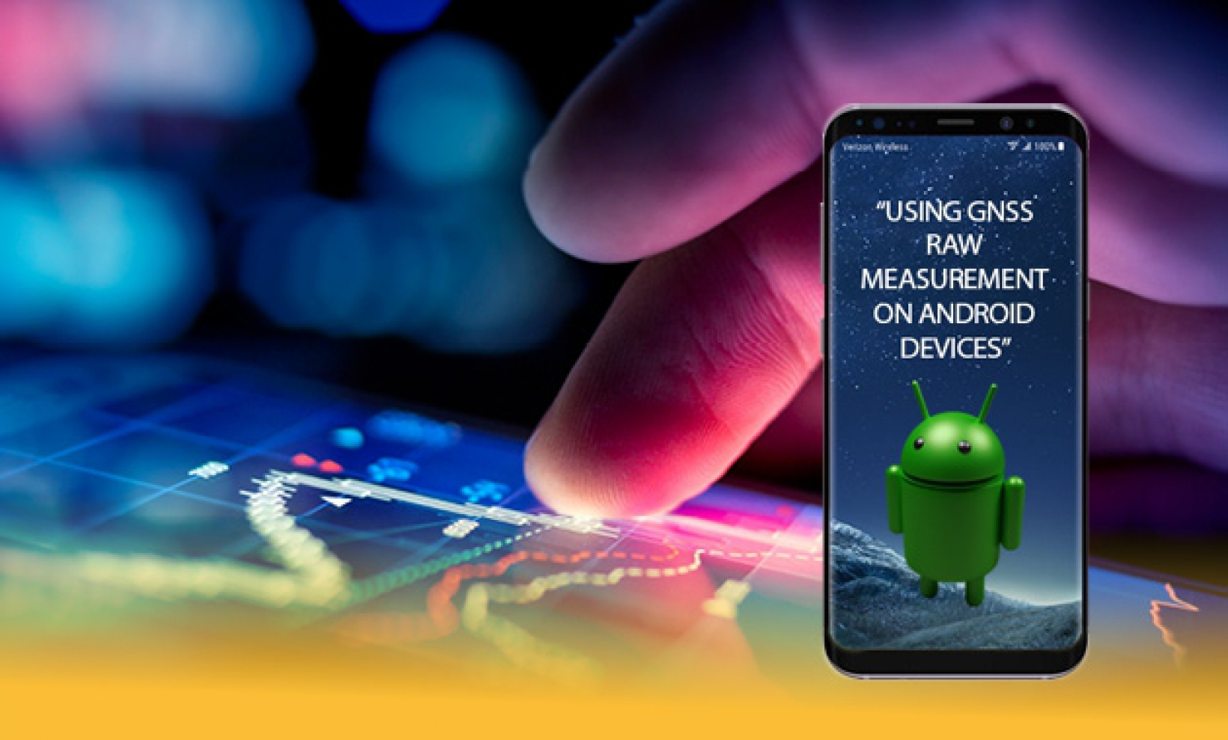

WHAT ARE GNSS RAW MEASUREMENTS?
With the raw measurements, Android users are now able to calculate pseudoranges (the distance between the user’s receiver and the satellite) and position, velocity and time (PVT) on their own, using their Android device.

Slide 5
Continued…….
From API 24 (Android 7), developers have access to (API 23 and) the following GNSS raw and computed information via Android classes:
• GNSS Clock, that contains:
- Receiver time (used to compute the pseudorange);
- Clock bias.
• GNSS Navigation Message that contains:
- Navigation Message bits (all the constellations);
- Navigation message status.
• GNSS Measurement that contains:
- Received Satellite Time (used to compute the pseudorange);
- Code; - Carrier phase.

Slide 6
Benefits of gnss raw measurements
Scientific Use:
As the observations are provided in a much more coarse form they can be used for testing hardware and software solutions and for new post processing algorithms.
Integrity/Robustness:
Acess to raw measurements, will offer new ways to detect RF interferences and to locate the inference source by combining the measurements from multiple devices.

Slide 7
Continued………
Increased accuracy:
Raw measurements allow to use advanced positioning techniques once restricted to professional GNSS receivers(ex: RTK,PPP) that are able to improve the position accuracy.
Testing:
Raw measurements can also be used to compare solution from single constellations, eliminate specific satellites or test for worst scenario performance.

Slide 8

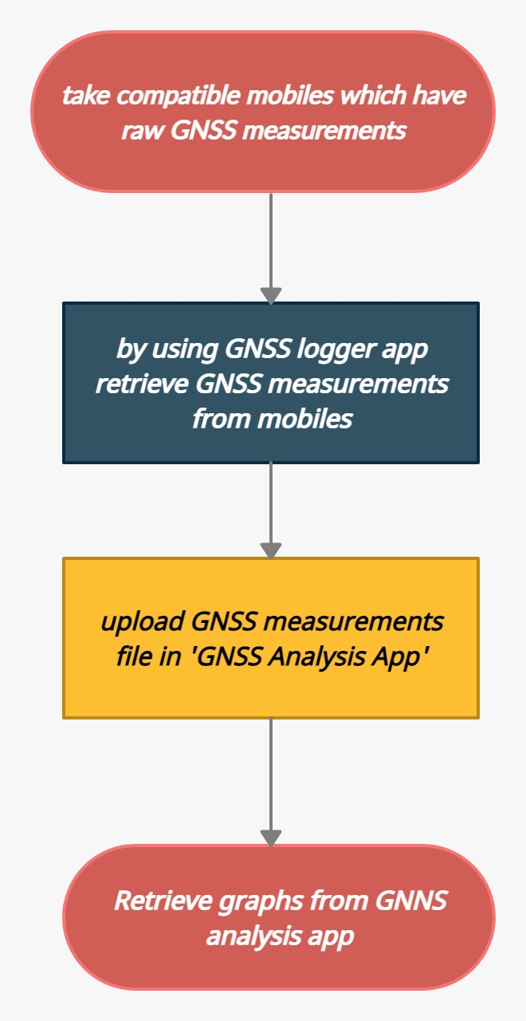

FLOWCHART

Slide 9
METHODOLOGY
We need to take single frequency or dual frequency mobiles devices which are compatible for raw GNSS measurements. For retrieving GNSS measurements, we need to install GNSS Logger app in mobiles. By using this GNSS Logger app, we can retrieve the raw measurements. After retrieving measurements file, we need to analyze that raw measurements. For analyzing, we need to install GNSS Analysis app on our desktop. By uploading the logger file in GNSS analysis app, we can retrieve the graphs. By this graphs we can analyse the raw measurements and can know the carrier density rato, pseudoranges and PVT.

Slide 10
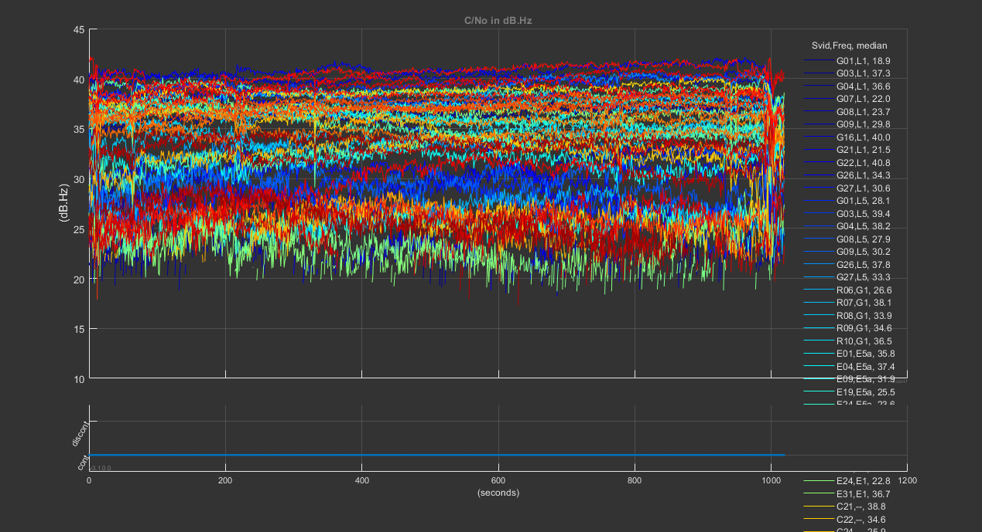
RESULTS

Slide 11
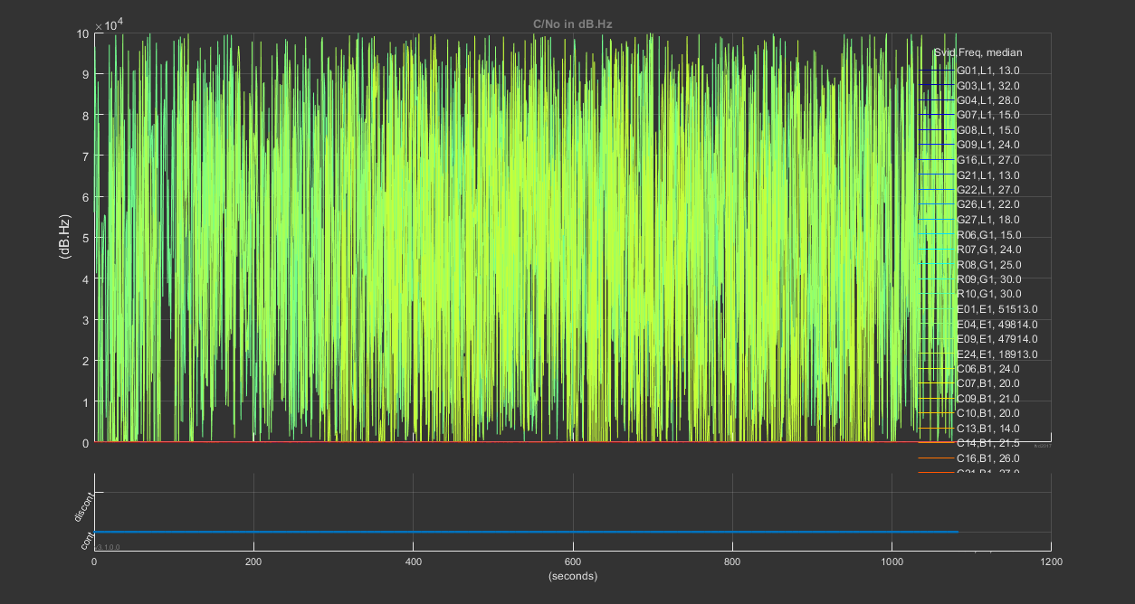

Slide 12
CONCLUSION
Finally with the help of our project, we can analyze the GNSS raw measurements by calculating the pseudo ranges and PVT.

Slide 13
REFERENCES
https://developer.android.com/guide/topics/sensors/gnss.html
https://insidegnss.com/gnss-analysis-tools-from-google/
https://insidegnss.com/compare/
https://sites.google.com/view/gnsstutorial/home
https://android-developers.googleblog.com/2017/10/gnss-analysis-tools-from-google.html

